Slide 1
Thesis Proposal - Behavioral Robustness of Software System Designs
Changjian Zhang
Thesis Committee:
Dr. Eunsuk Kang (Co-chair) Dr. David Garlan (Co-chair)
Dr. Jonathan Aldrich Dr. Sebastian Uchitel
Notes:
Add a progress tracker at the bottom.

Slide 2

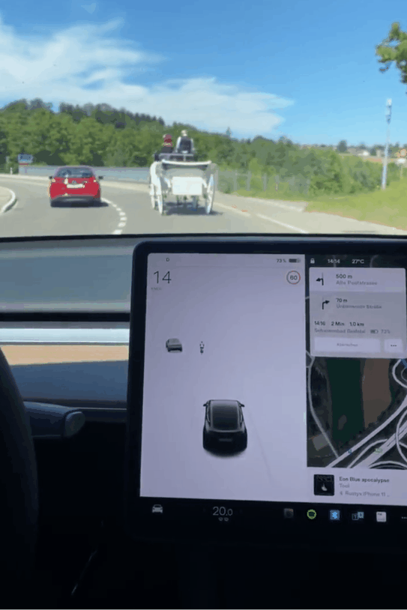
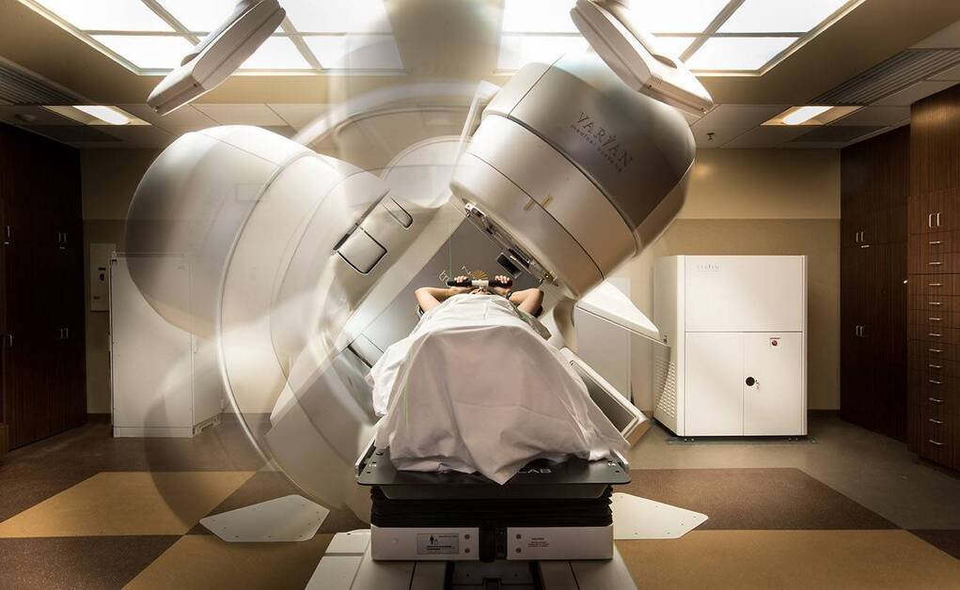
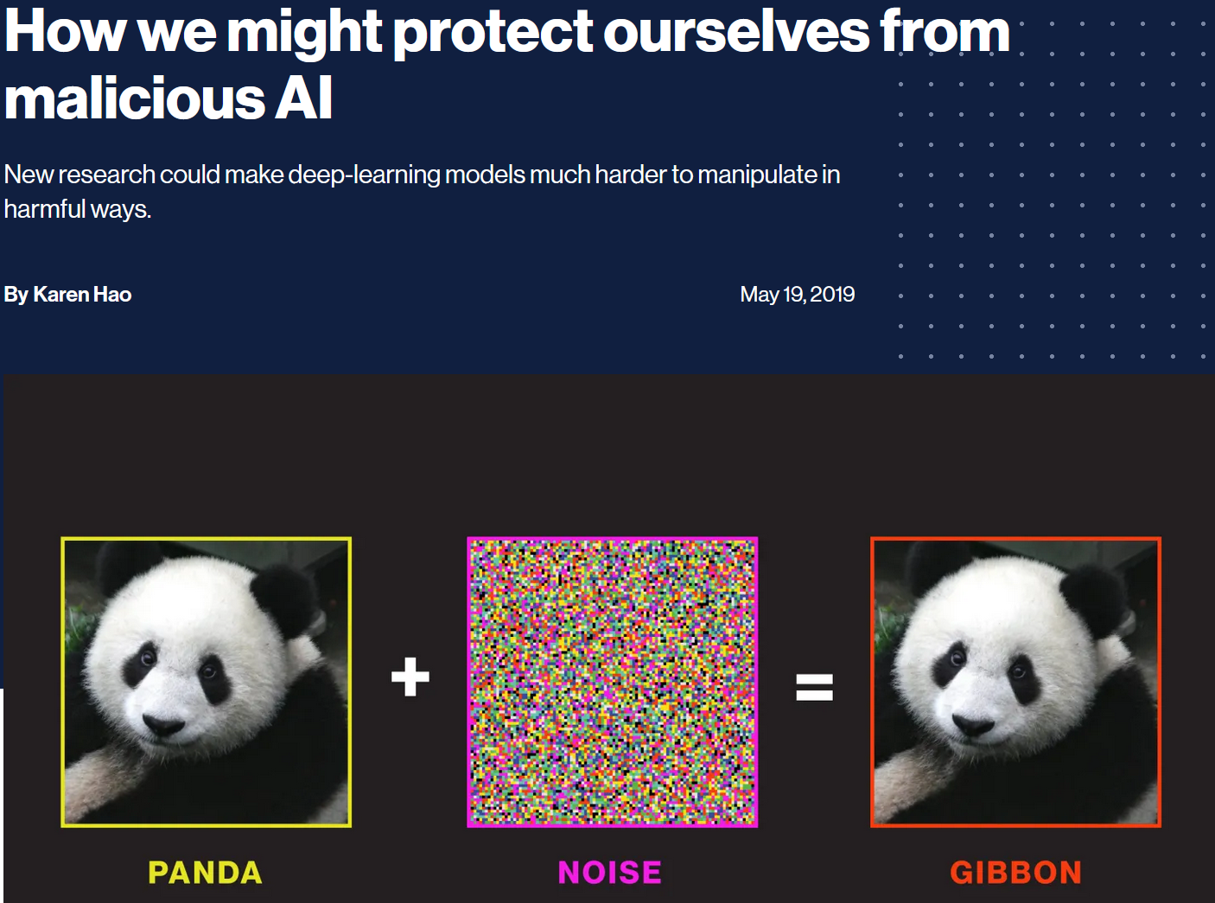
A Thesis about Software Robustness
Introduction | Related Work | Thesis Statement | Robustness | Robustification | Evaluation | Summary
“Robustness is the ability of a software system to continue functioning correctly in the presence of invalid inputs or stressful environment.”
What is Robustness?
Notes:
Apparently, we cannot address all of these in one study. In fact, they represent diff active research areas.

Slide 3
A Categorization of Robustness
Introduction | Related Work | Thesis Statement | Robustness | Robustification | Evaluation | Summary
I/O Relation vs Behavioral
Type of Systems
Input-Output Relations:
No erroneous outputs or crashes under invalid inputs (e.g., out-of-range values).
Behavior as States and Transitions:
Safety: not reaching bad states.
Liveness: reaching good states.
Maintain a property under unexpected env behavior.
Conventional Software Systems:
Discrete systems.
OS, web services, etc.
Machine Learning (ML) Systems:
Data driven, statistical model.
Cyber-Physical Systems (CPS):
Physical process + Software.
ODE, Hybrid Model
Drones, self-driving cars.
Notes:
Should mention type of CPS.
May change the order of the two columns

Slide 4
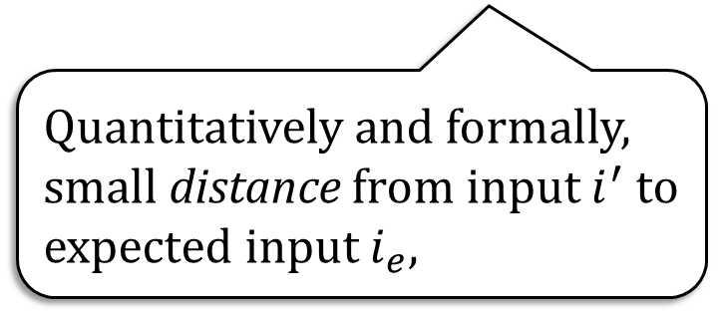
Existing Robustness Definitions
Introduction | Related Work | Thesis Statement | Robustness | Robustification | Evaluation | Summary
Qualitatively, if the inputs are invalid, e.g., out-of-range values,
Wrong output values? Crashes? (Koopman et al.)
Software Machine
Inputs
Outputs
Quantitatively and formally, small distance from input $i^{′}$ to expected input $i_{e}$,
Small distance value in the output value. (Tabuada et al.)
Notes:
Phillip Koopman, Paulo Tabuada

Slide 5
Our Work: Behavioral Robustness
Introduction | Related Work | Thesis Statement | Robustness | Robustification | Evaluation | Summary
System
Machine
Assumed
Env.
satisfy
Safety/Liveness Property
Deviations (Uncertainties): sequences of env events not defined.
satisfy?
Actual
Env.
Notes:
Emphasize on the type of uncertaints or deviations

Slide 6
Motivating Example: Therac-25
Introduction | Related Work | Thesis Statement | Robustness | Robustification | Evaluation | Summary

Slide 7
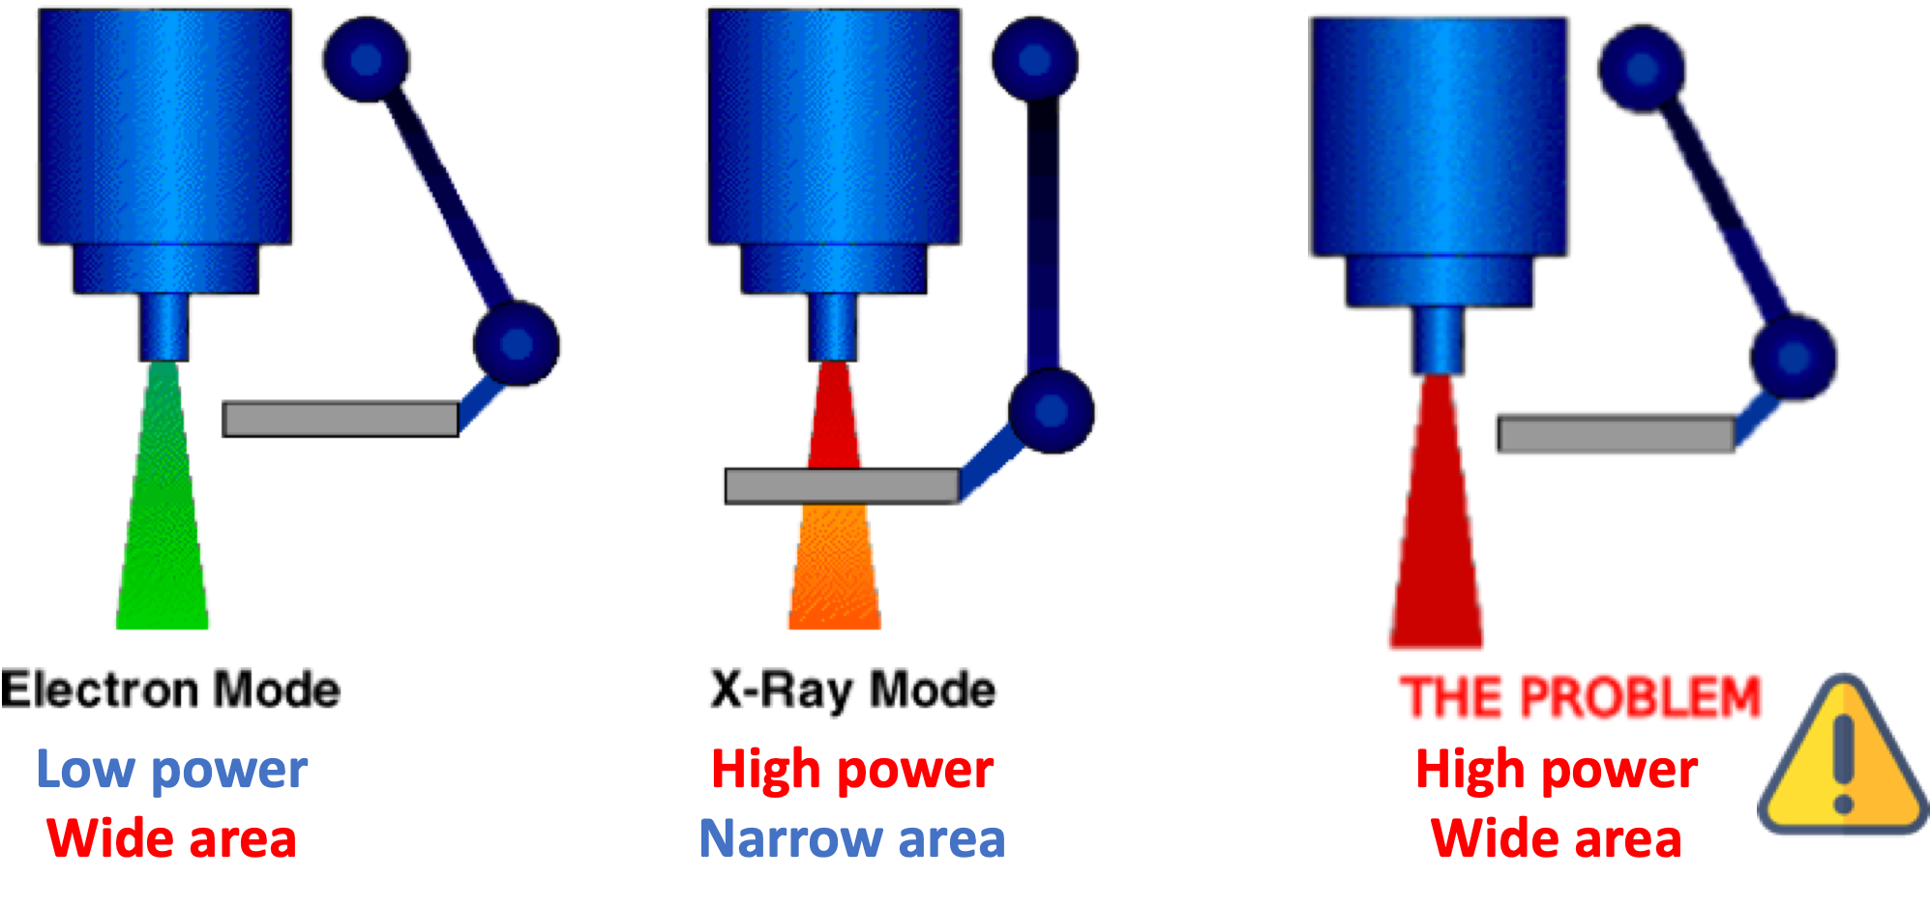
Therac-25 Machine
Introduction | Related Work | Thesis Statement | Robustness | Robustification | Evaluation | Summary
A spreader in place during X-Ray for safe radiation level.
Electron (EBeam) and X-Ray modes.

Slide 8
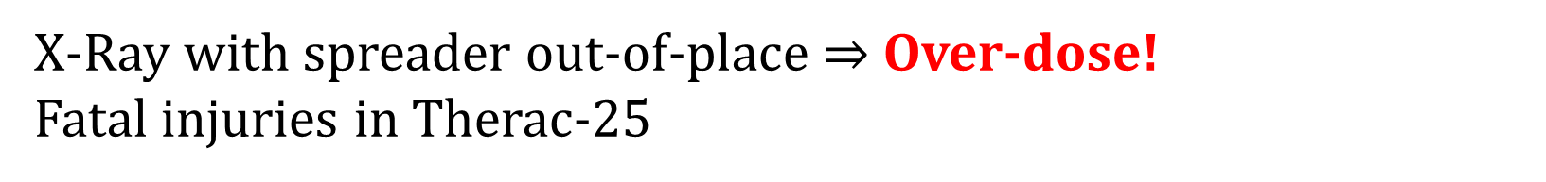
Therac-25 Safety Requirement
Introduction | Related Work | Thesis Statement | Robustness | Robustification | Evaluation | Summary
X-Ray with spreader out-of-place $⇒$ Over-dose!
Fatal injuries in Therac-25

Slide 9


Assumed Environment and Deviations
Introduction | Related Work | Thesis Statement | Robustness | Robustification | Evaluation | Summary
Assumed Env
Deviation
How can we build Robust-by-Design software?
Choose X-ray mode.
(Spreader moves in.)
Confirm mode.
Fire the beam.
Accidentally choose X-ray.
(Spreader moves in.)
Switch to Electron Beam.
(Spreader moves out.)
(Mode switch in progress!)
Confirm mode.
Fire X-ray without spreader.
Safe!
Unsafe and Unrobust!
Notes:
Mode switching is a machine event.

Slide 10



Robust-by-Design Software
Introduction | Related Work | Thesis Statement | Robustness | Robustification | Evaluation | Summary
Assessment: Methods to systematically measure robustness.
Design
Robustness
Analysis
Developer, Designer,
Architect
Improvement: Methods to systematically improve the robustness of a design.
Robustify
Design

Slide 11
Gaps in Robustness Assessment
Introduction | Related Work | Thesis Statement | Robustness | Robustification | Evaluation | Summary
Existing works mostly focus on testing against implementation.
Fault injection, model-based testing, fuzzing, …
Wrong outputs or crashes.
No formal guarantees.
Design
Robustness
Analysis
Developer, Designer,
Architect
Robustify
Design

Slide 12
Gaps in Robustness Improvement
Introduction | Related Work | Thesis Statement | Robustness | Robustification | Evaluation | Summary
Implementation improvement:
Wrapper of code.
Defensive programming, Clean Code, Effective Java, …
Self-adaptive system and Runtime assurance:
Improve “robustness” implicitly.
A broader set of properties: performance, availability, …
More than robustness, e.g., recoverability, …
Architecture tactics:
SEI robustness report.
Simplex architecture.
Design
Robustness
Analysis
Developer, Designer,
Architect
Robustify
Design
Notes:
Self-adaptive is basically reactive. Damage and recover.

Slide 13
Our Goal: Formal Analysis and Improvement of Behavioral robustness
Introduction | Related Work | Thesis Statement | Robustness | Robustification | Evaluation | Summary
RQ1: Can we qualitatively measure behavioral robustness of a machine design?
Design
Robustness
Analysis
Developer, Designer,
Architect
RQ2: Can we rigorously and systematically improve the behavioral robustness of a machine design?
Robustify
Design

Slide 14
Thesis Statement
Introduction | Related Work | Thesis Statement | Robustness | Robustification | Evaluation | Summary
Given a machine and its environment that can be formally modeled as a state-transition system, we can systematically measure and improve the behavioral robustness of the machine with respect to the environment and a system-level safety property.
Notes:
Emphasize on we can.

Slide 15
Contributions Overview
Introduction | Related Work | Thesis Statement | Robustness | Robustification | Evaluation | Summary
Contrib. 3: Develop a tool, Fortis, and conduct evaluation against 5 case studies.
Fortis
Formalism: Labeled Transition System (LTS)
Design
Robustness
Analysis
Contrib. 1: A behavioral notion of robustness based on LTS and its computation method.
Developer, Designer,
Architect
Contrib. 2: Improve behavioral robustness automatically by control and specification weakening.
Robustify
Design

Slide 16
Robustness Analysis
…, we can systematically measure and improve the behavioral robustness …
A behavioral notion of robustness.
Robustness computation and representation.
Notes:
Add a pointer back to the thesis statement.

Slide 17
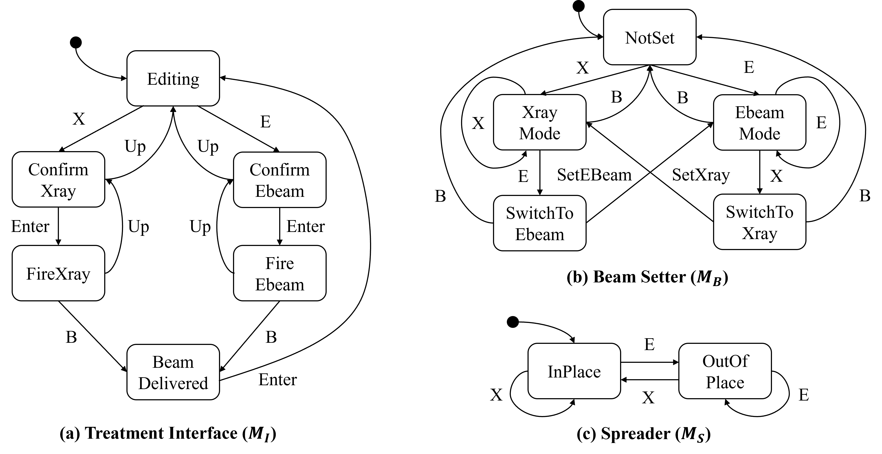
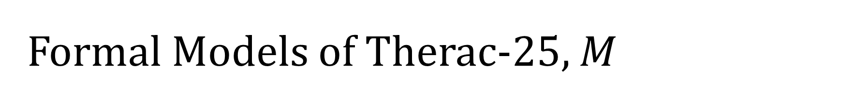
Formal Models of Therac-25, $M$
Introduction | Related Work | Thesis Statement | Robustness | Robustification | Evaluation | Summary

Slide 18
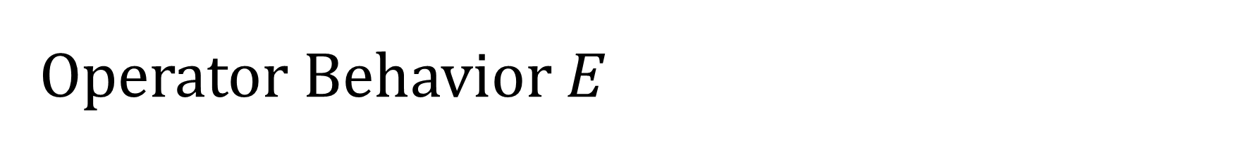
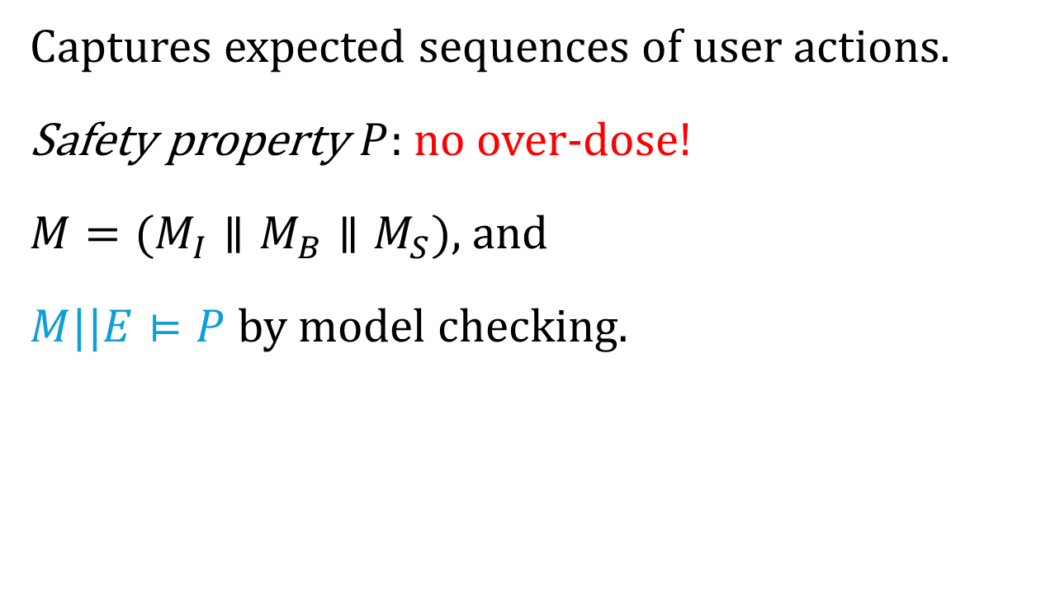
Operator Behavior $E$
Introduction | Related Work | Thesis Statement | Robustness | Robustification | Evaluation | Summary
Select Mode
Captures expected sequences of user actions.
Safety property $P$: no over-dose!
$M=(M_{I}∥M_{B}∥M_{S})$, and
$M||E⊨P$ by model checking.
X
E
Confirm Mode
Enter
Fire Beam
B
Task Complete
Notes:
Our assumption is that, the machine should satisfy the desired property given the assumed env.

Slide 19
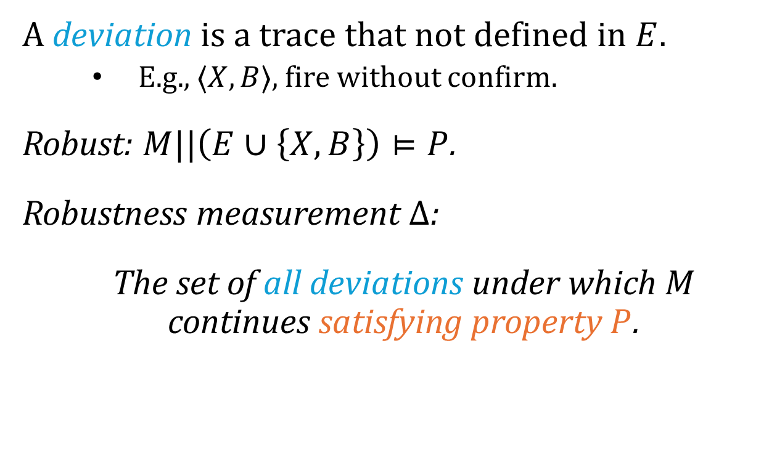
Deviation and Robustness
Introduction | Related Work | Thesis Statement | Robustness | Robustification | Evaluation | Summary
Select Mode
A deviation is a trace that not defined in $E$.
E.g., $⟨X,B⟩$, fire without confirm.
Robust: $M||\left(E∪\left\{X,B\right\}\right)⊨P$.
Robustness measurement $Δ$:
The set of all deviations under which $M$ continues satisfying property $P$.
X
E
Confirm Mode
Enter
Fire Beam
B
B
Task Complete

Slide 20
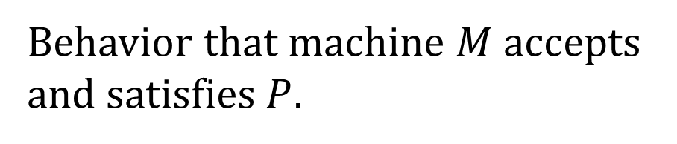
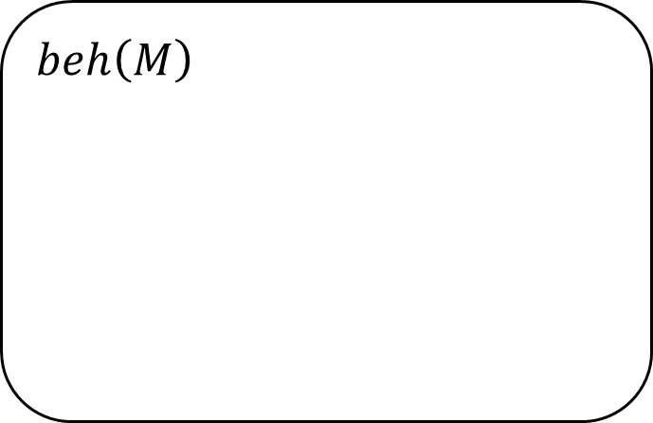
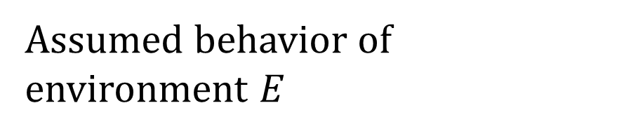
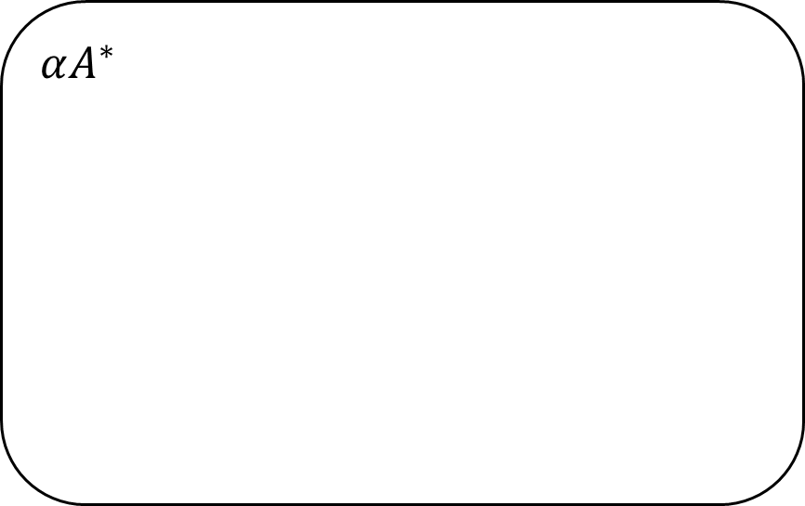
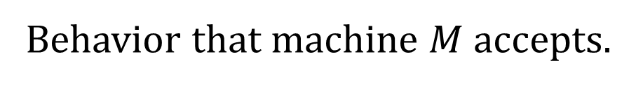
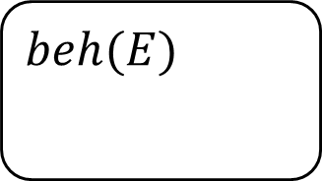
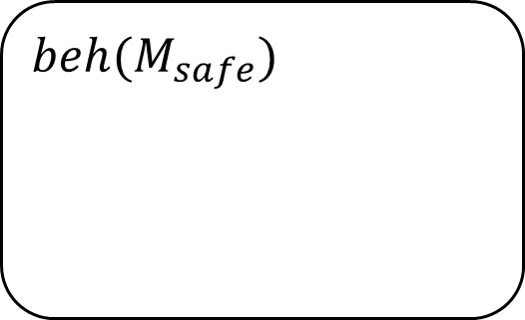
Robustness Computation
Introduction | Related Work | Thesis Statement | Robustness | Robustification | Evaluation | Summary
$$αA^{∗}$$
Behavior that machine $M$ accepts.
$$beh\left(M\right)$$
$$beh(M_{safe})$$
Behavior that machine $M$ accepts and satisfies $P$.
$$beh(E)$$
Assumed behavior of environment $E$

Slide 21
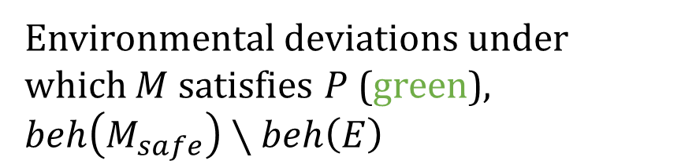
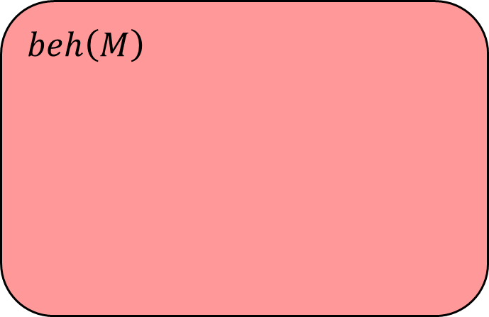
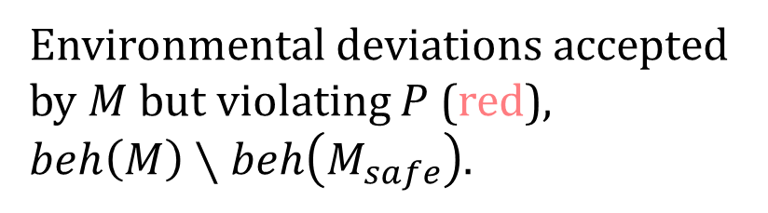
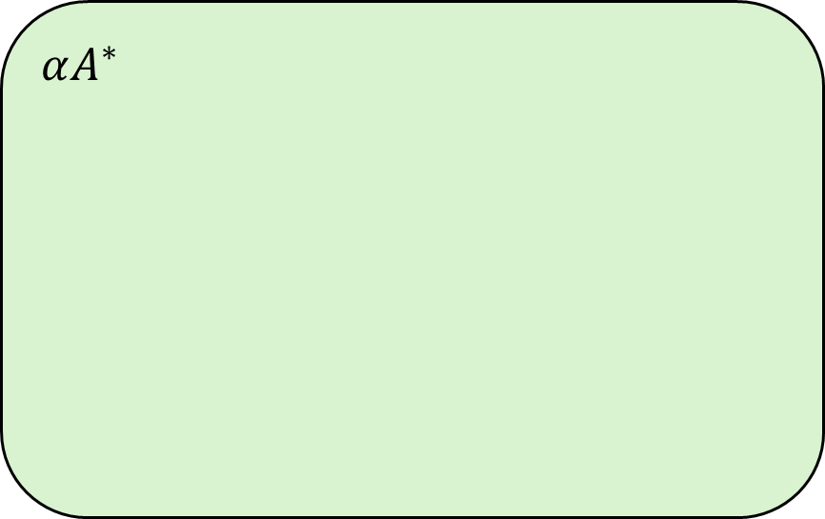
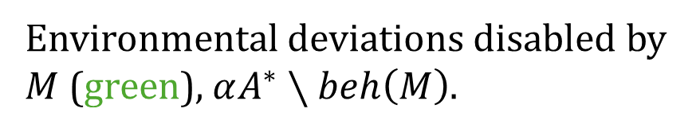
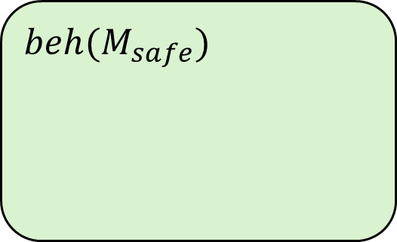
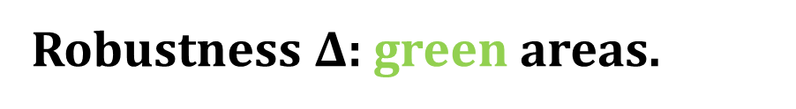
Robustness Computation
Introduction | Related Work | Thesis Statement | Robustness | Robustification | Evaluation | Summary
Environmental deviations disabled by $M$ (green), $αA^{∗}∖beh\left(M\right)$.
$$αA^{∗}$$
$$beh\left(M\right)$$
Environmental deviations accepted by $M$ but violating $P$ (red), $beh\left(M\right)∖beh\left(M_{safe}\right)$.
$$beh(M_{safe})$$
$$beh(E)$$
Environmental deviations under which $M$ satisfies $P$ (green), $beh\left(M_{safe}\right)∖beh\left(E\right)$
Robustness $Δ$: green areas.

Slide 22
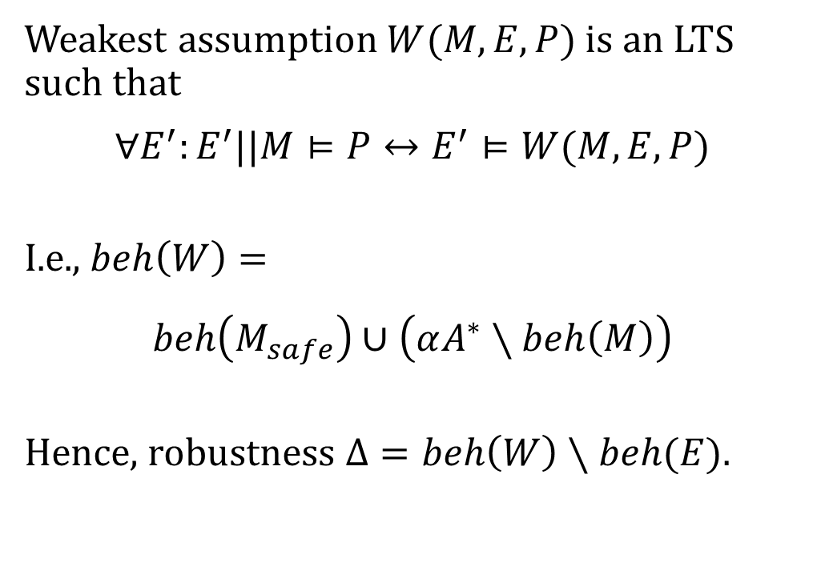
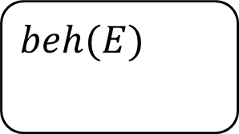
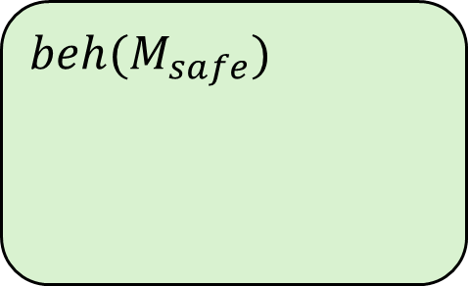
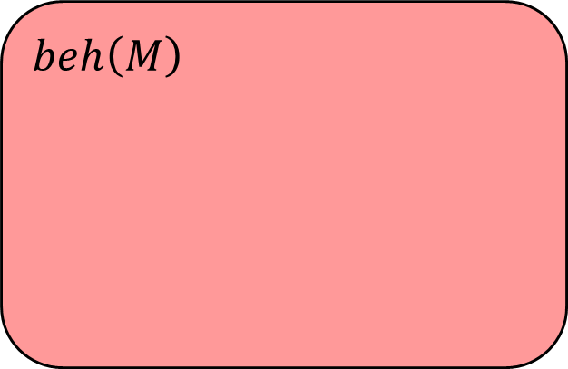
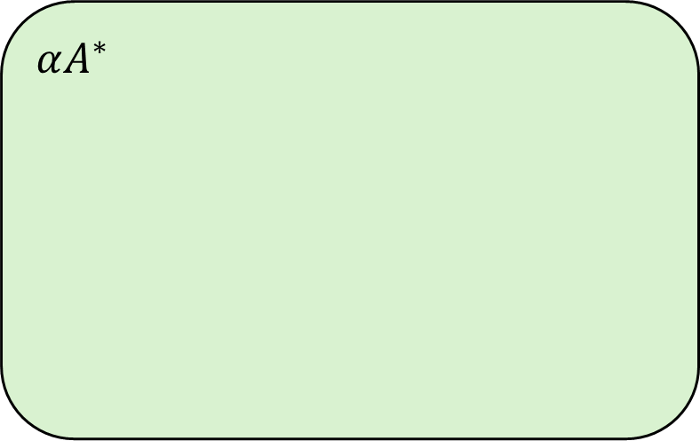
Robustness and Weakest Assumption
Introduction | Related Work | Thesis Statement | Robustness | Robustification | Evaluation | Summary
Weakest assumption $W(M,E,P)$ is an LTS such that
$$∀E^{′}:E^{′}||M⊨P↔E^{′}⊨W(M,E,P)$$
I.e., $beh\left(W\right)=$
$$beh\left(M_{safe}\right)∪\left(αA^{∗}∖beh\left(M\right)\right)$$
Hence, robustness $Δ=beh\left(W\right)∖beh(E)$.
$$αA^{∗}$$
$$beh\left(M\right)$$
$$beh(M_{safe})$$
$$beh(E)$$

Slide 23
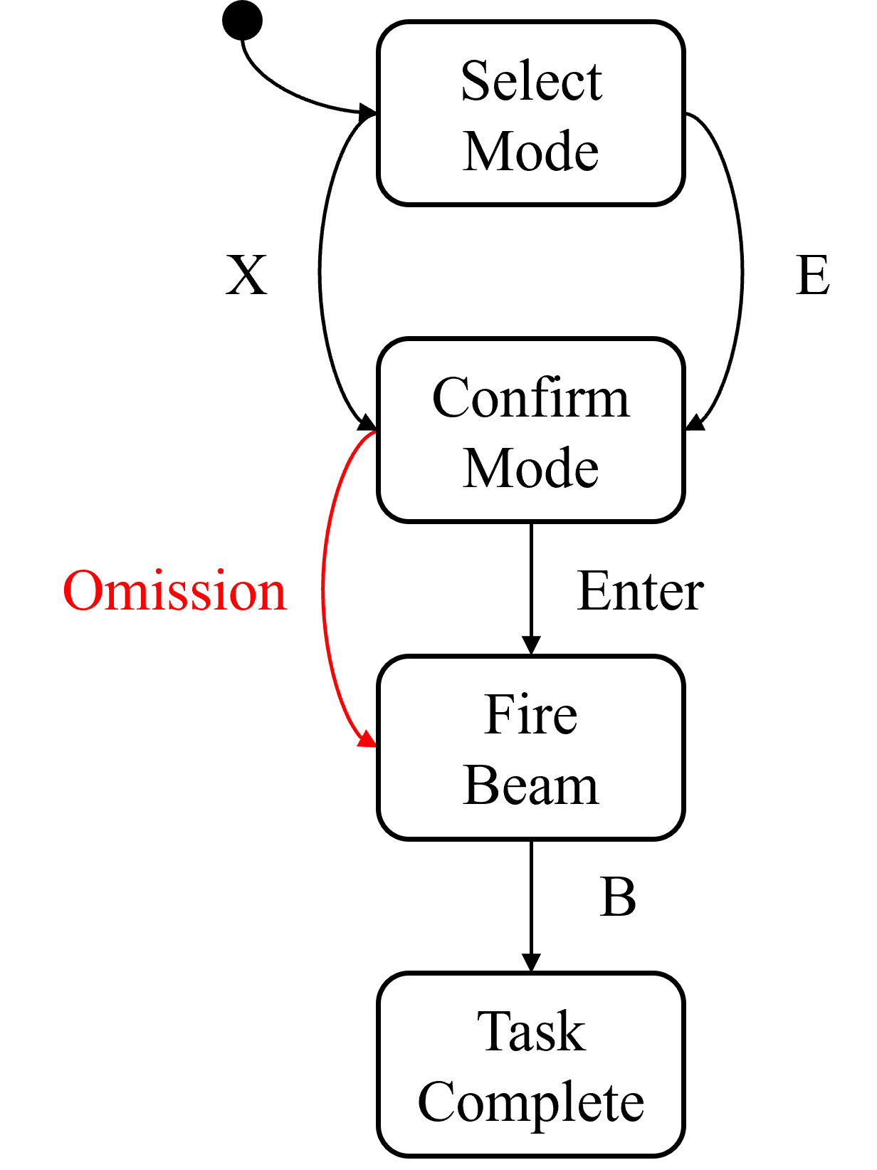
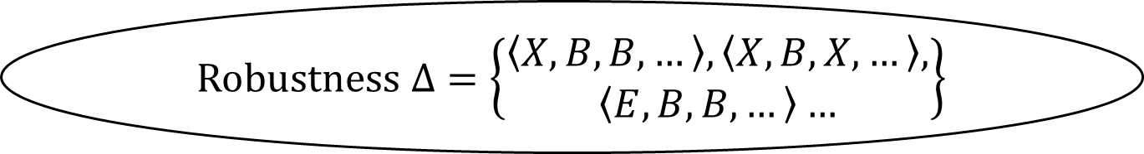
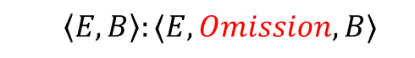
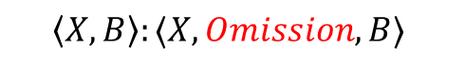
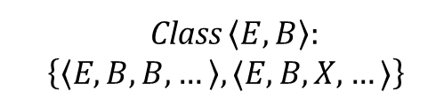
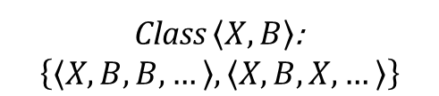
Robustness Representation and Explanation
Introduction | Related Work | Thesis Statement | Robustness | Robustification | Evaluation | Summary
Robustness $Δ=\left\{\begin{aligned}\left\langle X,B,B,…\right\rangle ,\left\langle X,B,X,…\right\rangle , \\ \left\langle E,B,B,…\right\rangle …\end{aligned}\right\}$
Deviation Model
Extract equivalence classes
Class $\left\langle X,B\right\rangle$:
$$\left\{\left\langle X,B,B,…\right\rangle ,\left\langle X,B,X,…\right\rangle \right\}$$
Class $\left\langle E,B\right\rangle :$
$$\left\{\left\langle E,B,B,…\right\rangle ,⟨E,B,X,…⟩\right\}$$
……
Generate explanations
$$\left\langle X,B\right\rangle :⟨X,Omission,B⟩$$
$$\left\langle E,B\right\rangle :⟨E,Omission,B⟩$$
……
Notes:
Recall X, B.

Slide 24
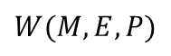
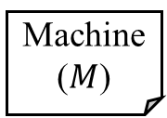
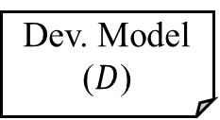
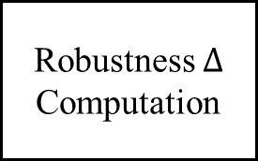
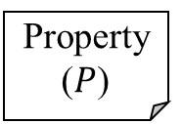
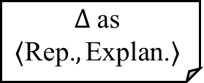
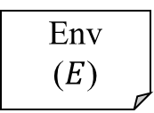
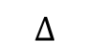
Robustness Analysis Summary
Introduction | Related Work | Thesis Statement | Robustness | Robustification | Evaluation | Summary
Dev. Model ($D$)
Machine ($M$)
Weakest Assumption Generation
Robustness $Δ$ Computation
Representation Traces and Explanations
Env
($E$)
$$Δ \text{as}$$
$$⟨\text{Rep}\text{.}, \text{Explan}\text{.}⟩$$
$$W(M,E,P)$$
$$Δ$$
Property ($P$)
A behavioral notion of robustness for software systems. Changjian Zhang, David Garlan, and Eunsuk Kang. (FSE 2020)
Notes:
Mentioned there are other components can be found in the proposal and paper.

Slide 25
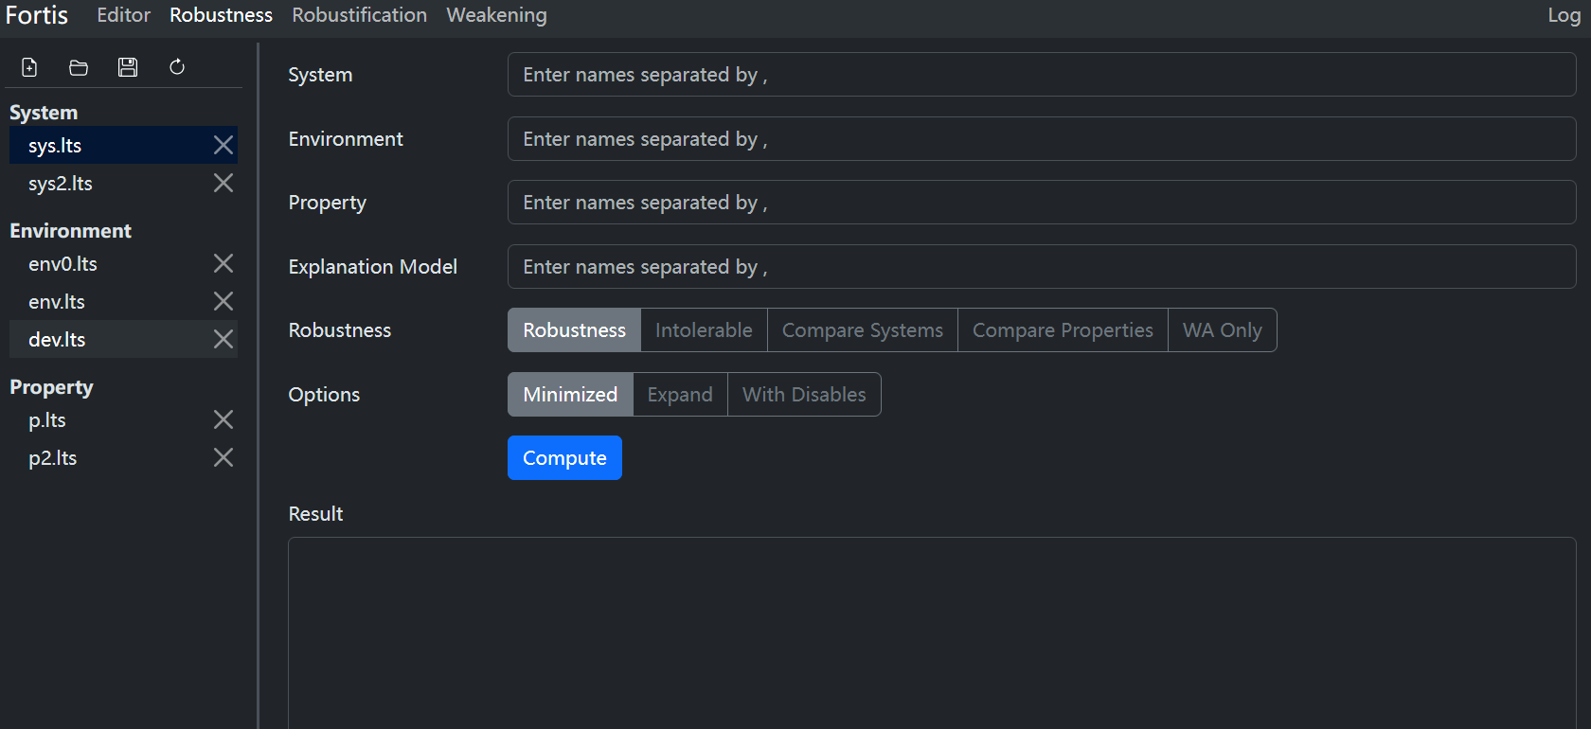
Fortis: Robustness Computation
Introduction | Related Work | Thesis Statement | Robustness | Robustification | Evaluation | Summary

Slide 26
Design Robustification
…, we can systematically measure and improve the behavioral robustness …
Robustification by Control.
Robustification by Specification Weakening (On-going).

Slide 27
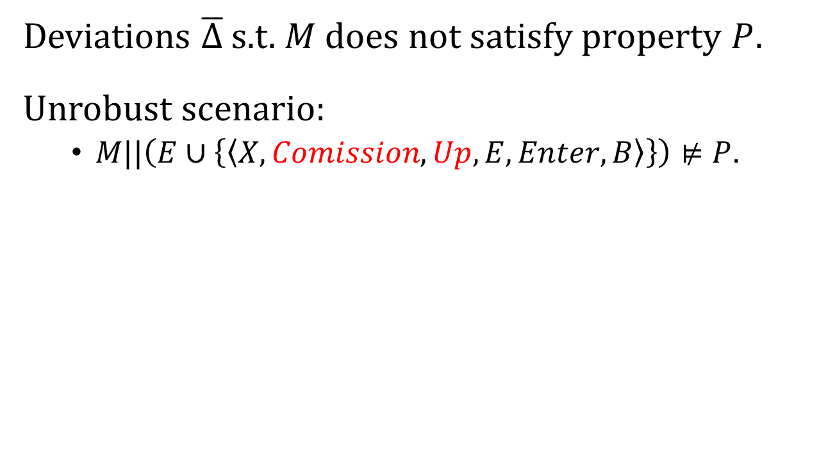
Intolerable Deviations
Introduction | Related Work | Thesis Statement | Robustness | Robustification | Evaluation | Summary
Select Mode
Deviations $\overline{Δ}$ s.t. $M$ does not satisfy property $P$.
Unrobust scenario:
$M||\left(E∪\left\{\left\langle X,Comission,Up,E,Enter,B\right\rangle \right\}\right)⊭P$.
Up
Go Back
X
E
Confirm Mode
Commission
Mode switching not completed yet!
Enter
Fire Beam
B
Task Complete
Transiting to

Slide 28
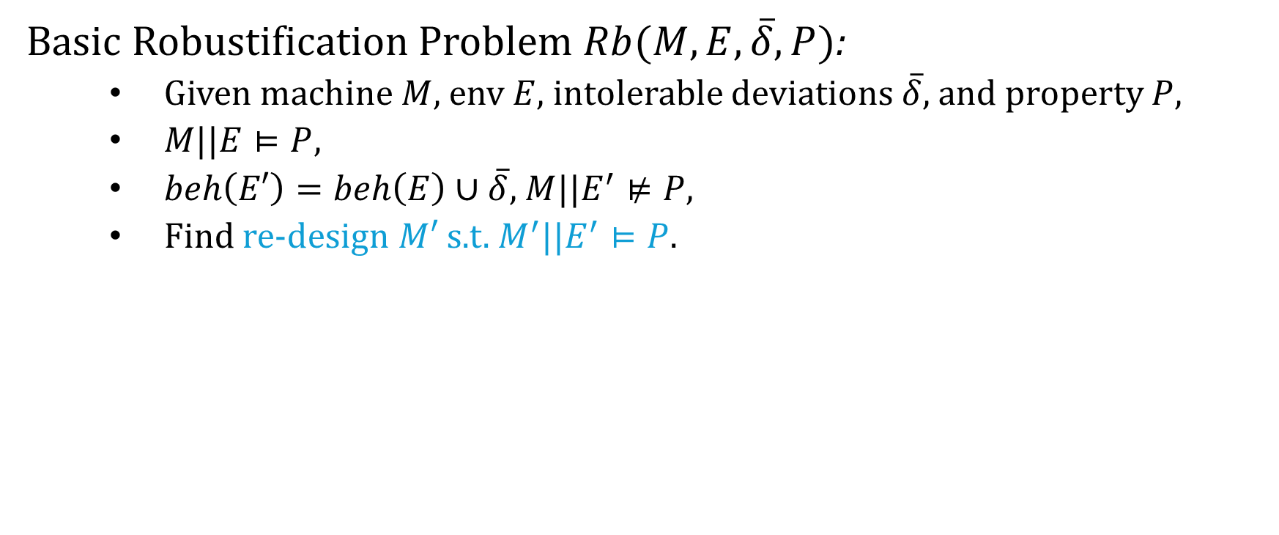
Robustification Problem
Introduction | Related Work | Thesis Statement | Robustness | Robustification | Evaluation | Summary
Basic Robustification Problem $Rb(M,E,\overline{δ},P)$:
Given machine $M$, env $E$, intolerable deviations $\overline{δ}$, and property $P$,
$M||E⊨P$,
$beh\left(E′\right)=beh\left(E\right)∪\overline{δ}$, $M||E^{′}⊭P$,
Find re-design $M′$ s.t. $M^{′}||E^{′}⊨P$.

Slide 29
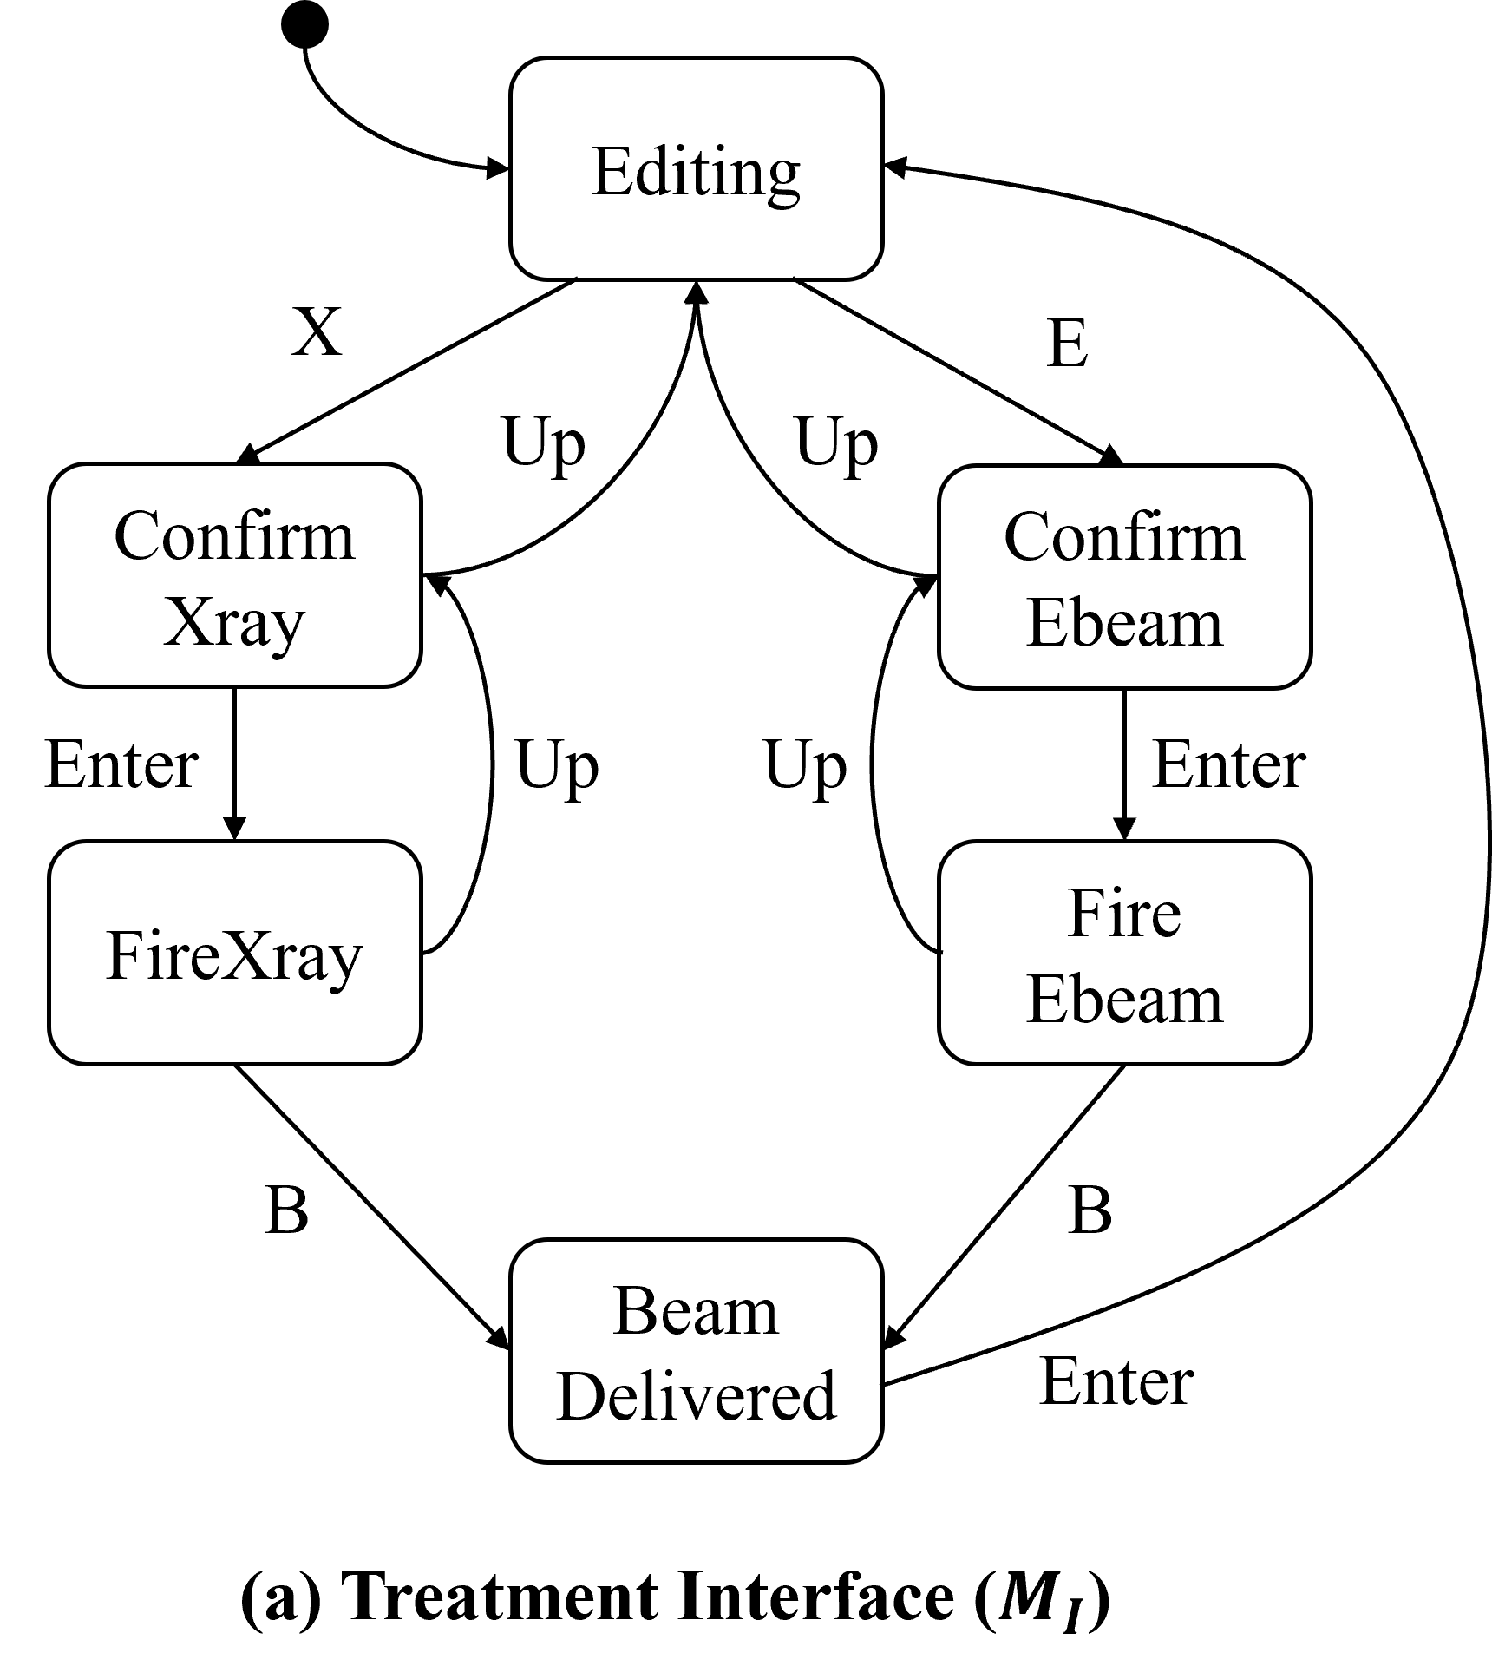
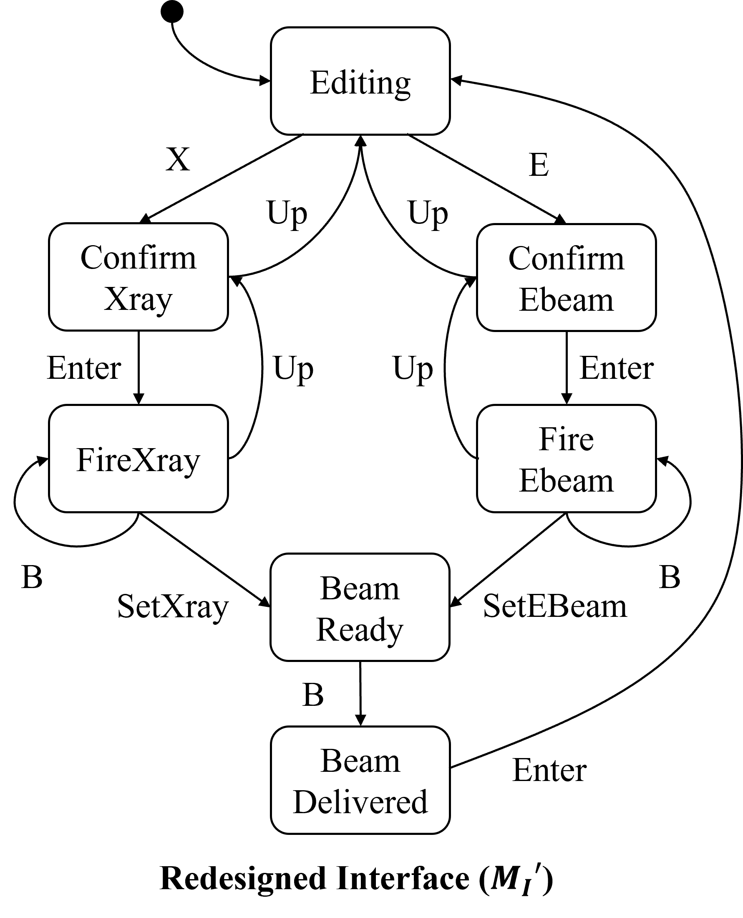
Trade-Offs between Solutions
Introduction | Related Work | Thesis Statement | Robustness | Robustification | Evaluation | Summary
Disable all up actions
Synchronize on mode-switching
Better functionalities, but Higher cost
Low cost, but Lose functionalities
Notes:
Cost to implement this design.

Slide 30
Dimensions of Trade-Offs
Introduction | Related Work | Thesis Statement | Robustness | Robustification | Evaluation | Summary
Safety
Retain Functionalities
(“Liveness”)
Observability
Controllability
Cost
Main goal is to ensure safety (e.g., by disabling actions).
But it may hurt functionalities (e.g., a machine that does nothing).
Increasing observability and controllability may allow finer-grained control.
But it may introduce additional implementation cost.

Slide 31
Robustification by Control
Design synthesis for safety through supervisory control theory.
Multi-objective optimization.

Slide 32
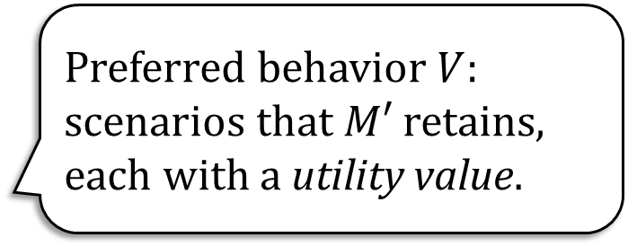


Robustification by Control
Introduction | Related Work | Thesis Statement | Robustness | Robustification | Evaluation | Summary
Ensure safety by disabling actions.
Safety
Retain Functionalities
(“Liveness”)
Observability
Controllability
Cost
Preferred behavior $V$: scenarios that $M′$ retains, each with a utility value.
Observable and control-able events, $A=(A_{O}, A_{C} )$.
Each event in $A$ is associated with a cost.

Slide 33

Multi-Objective Optimization
Introduction | Related Work | Thesis Statement | Robustness | Robustification | Evaluation | Summary
Safety
Retain Functionalities
(“Liveness”)
Observability
Controllability
Cost
Utility function:
$$U\left(V^{′},A^{′}\right)=\left\langle U_{V}\left(V^{′}\right),U_{A}\left(A^{′}\right)\right\rangle$$
Find redesign $M’$ s.t. maximizes utility $U\left(V^{′},A′\right)$ where $V^{′}⊆V,A^{′}⊆A$.
Pareto-Front
Cost
Pareto-Optimal
Preferred Beh.

Slide 34
Supervisory Control Theory
Introduction | Related Work | Thesis Statement | Robustness | Robustification | Evaluation | Summary
Controller
Observe events in the machine and env.
Ensure the safety property by disabling events.
System
Machine
Deviated
Env.
satisfy
Property

Slide 35

Optimal Robustification by Control
Introduction | Related Work | Thesis Statement | Robustness | Robustification | Evaluation | Summary
Supervisory Control finds a controller $S$ s.t.
$M||E^{′}||S⊨P$, thus new design $M^{′}=M||S$.
Given events $(A_{o},A_{c})$, $S$ disables minimally needed events, i.e., retaining as much behavior as possible.
Algorithm for finding optimal solutions:
Search for a tuple of $⟨V^{′},A^{′}=(A_{o}^{′},A_{c}^{′})⟩$,
Synthesize a new design $M^{′}=M||S$,
Compute utility $U\left(V^{′},A^{′}\right)$,
Repeat…
Cost
Preferred Beh.

Slide 36








Robustification by Control Summary
Introduction | Related Work | Thesis Statement | Robustness | Robustification | Evaluation | Summary
Machine ($M$)
Env
($E$)
Property ($P$)
$$V^{′}⊆V$$
$${(A}_{c}^{′},A_{o}^{′})⊆(A_{c},A_{o})$$
Design Optimizer
Supervisory Control Synthesis
Candidate Solution $M’$
Intolerable Dev. ($\overline{δ}$)
Pref. Behaviors ($V$)
Ctrl./Obs. Events ($A_{c},A_{o}$)
Optimal new designs $M’$
Robustification of Behavioral Designs against Environmental Deviations. Changjian Zhang, Tarang Saluja, Romulo Meira Goes, Matthew Bolton, David Garlan, and Eunsuk Kang. (ICSE 2023).

Slide 37

Fortis: Robustification by Control
Introduction | Related Work | Thesis Statement | Robustness | Robustification | Evaluation | Summary

Slide 38
Ongoing Work: Robustification by Specification Weakening
Safety LTS and FLTL.
LTL Learning.

Slide 39

Weaken the Safety Property
Introduction | Related Work | Thesis Statement | Robustness | Robustification | Evaluation | Summary
A strong safety property $P$ may be too restrictive to enforce.
E.g., avoiding over-dose and under-dose
To enforce safety and retain functionalities:
$M′$ observes and synchronizes on both $SetXray$ and $SetEBeam$.
Might be costly.
If under-dose could be relaxed $P′$:
$M^{′′}$ observe’ only one of them, cheaper.
Safety
Retain Functionalities
(“Liveness”)
Observability
Controllability
Cost

Slide 40
Fortis and Evaluations
…, we can systematically measure and improve the behavioral robustness …
A tool implementing the proposed approaches.
Evaluations based on 5 case studies.

Slide 41

Fortis: A Tool for Robust-by-Design
Introduction | Related Work | Thesis Statement | Robustness | Robustification | Evaluation | Summary
Notes:
This should come earlier.

Slide 42
Fortis: Robustness Computation
Introduction | Related Work | Thesis Statement | Robustness | Robustification | Evaluation | Summary

Slide 43
Fortis: Robustification by Control
Introduction | Related Work | Thesis Statement | Robustness | Robustification | Evaluation | Summary

Slide 44

Fortis: Robustification by Specification Weakening (On-going)
Introduction | Related Work | Thesis Statement | Robustness | Robustification | Evaluation | Summary

Slide 45
Evaluation: Applicability and Performance
Introduction | Related Work | Thesis Statement | Robustness | Robustification | Evaluation | Summary
RQ: Is our technique applicable across multiple domains of problems?
Demonstrate through case studies: network protocols, medical devices, safety-critical/mission-critical systems.
Computed robustness corresponds to deviations in the respective domains.
Able to find re-designs that improves robustness.
RQ: How efficient does our approach perform? How well does it scale?
Derive benchmarks from the case studies.

Slide 46

Evaluation Case Studies
Introduction | Related Work | Thesis Statement | Robustness | Robustification | Evaluation | Summary
Therac-25 radiation machine
ABP protocol
iVotronic voting machine
Oyster public transportation system
Infusion pump
Notes:
Why these are chosen? What are things we will do in the future? Trace back to why we need these case studies. What experiments and evaluation we have done. Relate back to the thesis statement.

Slide 47

Robustness Computation Results
Introduction | Related Work | Thesis Statement | Robustness | Robustification | Evaluation | Summary

Slide 48

Robustification by Control Results
Introduction | Related Work | Thesis Statement | Robustness | Robustification | Evaluation | Summary

Slide 49
Summary

Slide 50
Expected Contributions
Introduction | Related Work | Thesis Statement | Robustness | Robustification | Evaluation | Summary
A tool, Fortis, and evaluate applicability and performance against 5 case studies.
Formalism: Labeled Transition System (LTS)
Given a machine and its environment that can be formally modeled as a state-transition system, we can systematically measure and improve the behavioral robustness of the machine with respect to the environment and a system-level safety property.
A behavioral notion of robustness based on LTS and its computation method.
Improve behavioral robustness automatically by control and specification weakening.
Notes:
Remind the audience what’s the def of robustness. Point back to the thesis statement.

Slide 51
Research Scope
Introduction | Related Work | Thesis Statement | Robustness | Robustification | Evaluation | Summary
We do not consider:
ML and CPS: requires significant changes in formalisms and approaches, e.g., probabilistic models and statistical model checking.
Other types of uncertainties (deviations): unknown events, the probability associated to an event, etc.
Liveness: requires significant different approaches, e.g., demanding adding retries for a protocol.
Evaluation of the tool, Fortis, w.r.t. other quality attributes such as usability and extensibility.
Notes:
Reemphasize CPS I mean continuous model.

Slide 52
Progress and Plan
Introduction | Related Work | Thesis Statement | Robustness | Robustification | Evaluation | Summary
 | Description | Est. Time Remains
Must-Haves | A behavioral notion of software robustness based on LTS. | Completed
 | The computation of robustness w.r.t. safety properties | Completed
 | Robustification by control. | Completed
 | Robustification by specification weakening. | 3 months
May-Haves | Evaluation over a large-scale, real-world system. | 3+ months
 | Improving and evaluating the quality of Fortis. | 2+ months
Won’t-Haves | Robustness w.r.t. liveness properties. | N/A
 | Robustness w.r.t. ML systems or CPS. | N/A
Notes:
For the real-world case study, what it can provide to support this thesis. That existing case studies cannot show.

Slide 53
Gaps in Robustness Assessment
Existing works are mainly experimental focusing on testing:
Evaluating against a software implementation.
Methods: fault injection, model-based testing, fuzzing, …
More about Input-Output Relationships.
Limitations:
Implementation focus rather than design.
Focus on IO-robustness rather than behavioral robustness.
Find violations but cannot provide robustness guarantees.
RQ: Can we qualitatively/quantitatively measure behavioral robustness of a machine design?
Notes:
Existing works for robustness assessment mainly …
The limitations: first, they mostly focus on implementation whereas we want to achieve robust-by-design.
…

Slide 54
Gaps in Robustness Improvement
Improve robustness of an implementation by wrappers or by improving code quality:
Wrappers over existing components to filter invalid inputs and erroneous outputs.
Defensive programming, Clean Code, Effective Java, …
Limitations:
Implementation focus rather than design.
Lack a systematic view of improving design robustness against a safety/liveness property.
RQ: Can we rigorously and systematically improve the behavioral robustness of a machine design?
Notes:
The second limitation is that they lack a systematic view: like if we add a null-pointer checker in this function A, how does it improve the the robust of the entire system?

Slide 55
“Robustness” in Self-Adaptive Systems
Self-adaptive system: maintain machine functionalities and quality attributes at run time against uncertainties.
Improve “robustness”, implicitly or explicitly.
A broader set of properties: performance, availability, …
Focusing on run-time assurance.
This work learned from them, but focuses more on:
Robust measurement (quantify uncertainties).
Design time robustness improvement.
Notes:
Other than these works which have an explicit robust tag, it is also important to note works from self-adaptive system and runtime ensurance.
E.g., self-adaptive system: …
Based on this definition, this also improve software robustness but may not explicitly use the term.
Also, they focus on a broader set of properties: …
However, the difference is that, in our work:
…

Slide 56
Behavioral Robustness of Conventional Software Systems
We study:
Conventional software systems modeled in discrete systems.
(Closed) System = Machine + Environment.
Behavior: sequences of states and transitions.
Behavioral property: safety property (not reaching bad states).
Unexpected behavior (deviations): sequences of environmental events not in the assumed environment.
Robustness: the capability of a machine to maintain a safety property under unexpected sequences of events from its actual environment that are not defined in the assumed environment.
Notes:
To elaborate on that, in this work, we study:

Slide 57

Rigorous and Systematic Reasoning by Formal Methods
A formal representation of a system design:
Mathematically represent the system behavior as execution traces.
E.g., normal execution of a protocol: $⟨send, recv, ack,get_ack⟩$,
Abnormal execution: $⟨send, send⟩$.
It enables us to:
Mathematically measure the behavioral robustness as a set of execution traces.
Mathematically and automatically improve robustness by model repair or synthesis.

Slide 58

Contrib. 1: Robustness Analysis
Given a machine $M$, an environment $E$, and a safety property $P$, all in LTS, assuming $M||E⊨P$:
Environmental deviation: a sequence of events not defined in $E$, but with the same alphabet,
E.g., in a network protocol, $E$ is a perfect channel as $⟨send,recv,ack,get_ack⟩$,
Then, $⟨send,send⟩$ is a deviation.
Robustness measurement $Δ$: a set of deviation traces that won’t cause a safety violation,
E.g., if $⟨send,send⟩$ does not cause a violation of $P$, then $M$ is robust against it.
Robustness computation: compute $Δ$, the set of all deviation traces such that $M||\left(E+Δ\right)⊨P$ and $∄Δ^{′}:Δ⊂Δ′$.

Slide 59

Robustness Analysis
Robustness representation: as $Δ$ can be infinite, generate a finite set of equivalence classes and sample representative traces.
Robustness explanation: explain how a deviation could occur and what environmental errors the machine is robust against,
E.g., deviation $\left\langle send,send\right\rangle$ can be caused by $\left\langle send,msg_lost,send\right\rangle$.
So, we could say the protocol is robust against message loss.

Slide 60
Contrib. 2a: Robustification by Wrapper
Safety
Preferred Scenarios
Observability
Controllability
Cost
Key tactic: monitor and disable events to ensure safety.
Liveness: a set of preferred scenarios.
Obsrv./Ctrl.: a set of observable and controllable events.
Cost: cost associated with implementing the events.
Solve a multi-objective optimization:
Retain liveness,
Minimize cost.
Notes:
Liveness is a bit confusing.
Arrows are confusing.

Slide 61

Contrib. 2b: Robustification by Specification Weakening
Safety
Liveness
Observability
Controllability
Cost
The safety property may be too restrictive.
Weaken the safety property ($P→P′$) to allow more deviations.
Use scenario:
Wrapper fails to find an ideal solution,
Weaken the safety property, and then
Re-apply wrapper.
Notes:
Add the arrows back to the other dimensions.

Slide 62

Labeled Transition System
An LTS is a tuple $⟨S,αT,R,s_{0}⟩$ where:
$S$ is a finite set of states,
$αT$ is a finite set of events, also called alphabet of T,
$R⊆S×αT∪\left\{τ\right\}×S$ defines the state transitions,
$s_{0}$ is the initial state.
A trace $σ∈αT^{∗}$ is an event sequence, $beh\left(T\right)$ is the set of all traces.
Parallel composition $||$: $T_{1}||T_{2}$ synchronizes on the same events and interleave on the others.
Safety LTS: an LTS describing the good behavior.

Slide 63


Robustness Representation and Explanation
Assume robustness $Δ=\left\{\left\langle X,B,B,…\right\rangle ,\left\langle X,B,X,…\right\rangle ,\left\langle E,B,B,…\right\rangle …\right\}$.
Equivalence classes: a normal execution + the first deviated action
Class $⟨X,B⟩$: $\left\{\left\langle X,B,B,…\right\rangle ,\left\langle X,B,X,…\right\rangle \right\}$
Class $⟨E,B⟩$: $\left\{\left\langle E,B,B,…\right\rangle ,⟨E,B,X,…⟩\right\}$
Explanation: use a deviation model $D$ to match the deviations.
E.g., $⟨X,B⟩$: $⟨X,Omission,B⟩$
Notes:
Change this to a conceptual diagram about why we need representation. Skip it.

Slide 64

Optimal Robustification Problem
Preferred Behavior: a set of scenarios $V$ that the new design should retain, each associated with an importance value.
Obsrv./Ctrl.: a set of observable and controllable events $A$.
Implementation Cost: the costs associated to observing and/or controlling a set of events $A$.
Optimal Robustification $Opt(Rb, V,A)$: find $⟨M^{′},V^{′}⊆V,A^{′}⊆A ⟩$ s.t. $M^{′}||E^{′}⊨P$, $V′$ are all retained in $M′$, and utility function $U$ is maximized:
$$U(V^{′},A′)=\left\langle U_{V}\left(V^{′}\right),U_{A}\left(A^{′}\right)\right\rangle$$
Notes:
Include a diagram of paretol optimal; remove some text.

Slide 65

Challenge: How to Weaken?
LTL safety invariants in $G(φ→ψ)$:
$G\left(Xray∧Fired→SpreaderIn\right)∧G(Ebeam∧Fired→!SpreaderIn)$
Translated to a safety LTS.
LTL learning from examples:
Given positive and negative examples,
Learn an LTL that separates the examples.

